Slide 1
PS 8- Patient Engagement Platform- Develop a platform or app that enhances patient engagement, allowing for better communication between patients and Hospitals / Doctors, appointment scheduling, medication reminders, and access to health information. MedZ - Where Health Meets Technology
Team Name - MAVERICK MINDS
Team No - TEAM75
College Name - PANIMALAR ENGINEERING COLLEGE

Slide 2
Team members Name | Mail id | Team faculty mentors | Mail id
AAMIR FAWAZ R | aamirfawaz11a@gmail.com | Dr.A.ANBARASA PANDIAN | anbuaec@gmail.com
ASMATH AKBAR ALI T | asmathakbarali@gmail.com
DEVOTTHAM D K | devoguha2213@gmail.com
JOSEPH PAUL MAMMEN | josephpaulmammen@gmail.com
Team details
Team Name- Maverick Minds
Team No - TEAM75
College Name – Panimalar Engineering College

Slide 3
Idea and thoughts to be implemented in the future
The next evolution of the Patient Engagement Platform aims to further improve healthcare accessibility and personalized care by introducing two powerful new features: Pharmacy Integration and Wearable Device Integration. These enhancements will empower patients to manage their medications more efficiently and allow doctors to monitor real-time health data, promoting more personalized and proactive care.
Pharmacy Integration: Patients can upload prescriptions, order medications for home delivery, and receive automatic refill alerts through the platform. This simplifies medication management, improves adherence, and ensures timely deliveries.
Wearable Integration: The platform integrates with wearable devices to track health data like heart rate and activity. Doctors can monitor real-time vitals and offer personalized care, enabling preventive healthcare and timely interventions for better health outcomes.

Slide 4
Pharmacy Integration: Simplifying Medication Management
Prescription Upload: Patients can upload prescriptions directly, while doctors can push them to the pharmacy system for fast processing.
Medicine Delivery: Patients can order medications for home delivery, with real-time tracking for convenience, especially for chronic patients.
Automatic Refill Alerts: The system tracks medication usage, sends refill reminders, and allows auto-refills, ensuring patients never miss a dose.
Impact: This feature reduces medication management burdens, improves treatment adherence, and ensures timely deliveries, enhancing overall patient care.

Slide 5
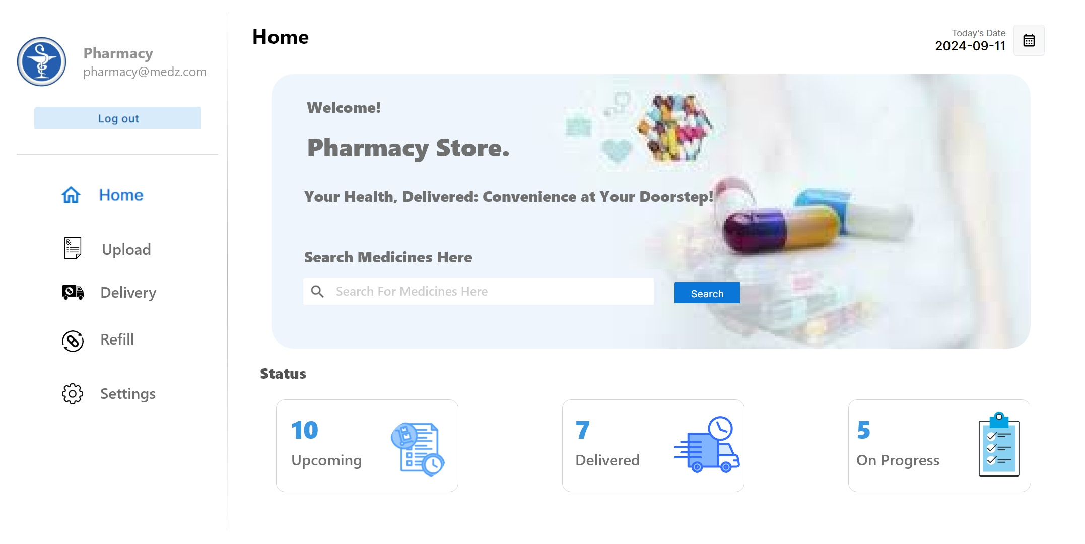

Slide 6
Wearable Integration: Real-time Health Monitoring
Health Tracking: The platform integrates with wearable devices to monitor vital stats like heart rate, sleep, and activity levels, providing real-time data to both patients and doctors.
Doctor-Patient Insights: Doctors can review patient health trends through the dashboard, offering personalized recommendations based on activity data and early detection of health issues.
Proactive Health Tips: The system provides automatic alerts and health suggestions, such as reminders for movement or addressing abnormal vitals.
Impact: Wearable integration enables proactive, preventive care, enhancing patient engagement and improving overall health outcomes.

Slide 7
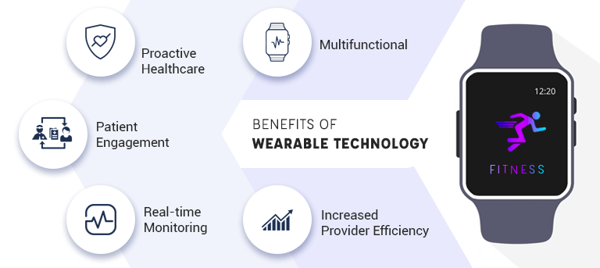

Slide 8
Thank you

